Slide 1
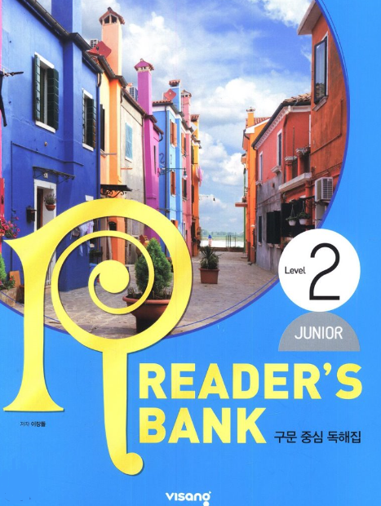
수업용
본문 PPT 자료
Reader’s Bank Level 2
Unit 08

Slide 2
Unit 08_01 개미야, 내 방엔 왜 왔니? / p.68
Reader’s Bank Level 2
Carol came back home from school. She saw a long line of ants. She followed it. She wanted to know where it started. She wanted to know what the ants were looking for. To her surprise, the line ended up in her bedroom! What did they want in there? She looked at her bed. Oh, no! There were bits of cake on it.

Slide 3
Unit 08_02 트럭 속 달걀에 무슨 일이? / p.69
Reader’s Bank Level 2
In China, an interesting thing took place on a truck. The truck was driving with many eggs in the back. The day was very hot, so the eggs started to hatch. Soon there were cute little chicks all over the truck. Some chicks even tried to climb out of the truck. But the driver did not know what was happening. He just kept driving.

Slide 4
Unit 08_03 지진을 예측하는 동물들_A / p.70
Reader’s Bank Level 2
Sometimes, animals are smarter than people. In 1975, many dogs in the city of Haicheng, China, started barking suddenly. Others ran into the hills. They looked scared. People couldn’t figure out why the dogs were acting in such an unusual way.

Slide 5
Unit 08_03 지진을 예측하는 동물들_B / p.71
Reader’s Bank Level 2
A few hours later, everything started to shake. The ground was shaking. Houses and buildings began to fall over. An earthquake was coming! Soon, the ground opened up. More buildings fell down. People don’t know when an earthquake will happen, but animals do.

Slide 6
Unit 08_04 해리 포터_A / p.72
Reader’s Bank Level 2
Harry Potter has no parents. They were killed by wizards. Harry lives with his aunt and uncle, but they are not kind to him. Harry feels lonely. He hates his hometown. One day, an owl brings him a message. The message tells Harry what to do. It tells him to go to a school called Hogwarts. Harry goes to Hogwarts with hopes and dreams. He learns magic skills from Dumbledore, an old teacher .

Slide 7
Unit 08_04 해리 포터_B / p.73
Reader’s Bank Level 2
At Hogwarts, Dumbledore teaches Harry many skills. Harry Potter learns how to do magic. He learns how to fight. When Harry Potter gets older and stronger, he fights with Lord Voldemort. Harry realizes that Voldemort is an evil man who killed his parents. While he is fighting with Voldemort, Harry gets badly hurt but gets well right away.

