Slide 1
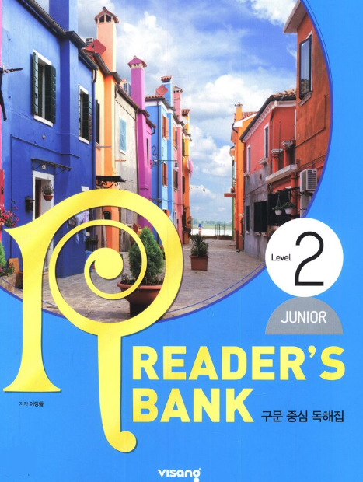
수업용
본문 PPT 자료
Reader’s Bank Level 2
Unit 10

Slide 2
Unit 10_01 물고기가 죽는 숨은 원인 / p.84
Reader’s Bank Level 2
I am a light and strong material. So people make bottles and boxes with me. But they throw me away after using me. I end up floating in the ocean. Since I look like food, some fish eat me. But I make them sick. Poor fish! Millions of fish die because of me. What am I?

Slide 3
Unit 10_02 미국인에게 이런 칭찬은 금물 / p.85
Reader’s Bank Level 2
Americans like to say nice things to other people. But they are very careful about their compliments. Compliments about clothing and hats are okay. But compliments about looks are not welcome. For example, if you give a woman a compliment on her lips or skin, it can make her upset. People are very sensitive to comments about their bodies.

Slide 4
Unit 10_03 음악의 위대한 효과_A / p.86
Reader’s Bank Level 2
Music changes our feelings. ( ① ) Sad music makes people sad, and happy music makes people happy. ( ② ) After the Second World War, many soldiers felt sad and became sick in the United States. ( ③ ) Musicians played happy music for them. ( ④ ) Then the soldiers became happy and healthy.
Music can improve our physical health, too.

Slide 5
Unit 10_03 음악의 위대한 효과_B / p.87
Reader’s Bank Level 2
Music can make people smarter. A researcher in the United States carried out an interesting experiment with college students. He played Mozart before a test. Surprisingly, the students who listened to the music did better on the test than those who didn’t. This is called the Mozart Effect. Today, many mothers play Mozart for their babies to get this effect.

Slide 6
Unit 10_04 자연의 어머니, 박테리아_A / p.88
Reader’s Bank Level 2
Bacteria are too small to see. ( ① ) But they are almost everywhere on Earth. You may think that they are bad. ( ② ) For example, bacteria in the soil break down dead plants and animals. ( ③ ) This makes the soil healthy. ( ④ ) Plants grow well in healthy soil. ( ⑤ ) Therefore, bacteria help plants grow better.
But most bacteria are helpful to us.

Slide 7
Unit 10_04 자연의 어머니, 박테리아_B / p.89
Reader’s Bank Level 2
Without bacteria’s help, we cannot make yogurt, cheese, or kimchi. Bacteria ferment these foods. In other words, bacteria turn the sugar in these foods into a kind of alcohol. As a result, these foods produce a special taste. Bacteria also play an important role in our bodies. They help us digest our food. They help us break down our waste. * ferment: 발효시키다

